Slide 1

BAYMAX
- Refined, accurate & quick search
Challenge: Build robust AI + ML services effortlessly with Azure ML
Team Members
Dikshant [1535]
Rakshit [1063]
Samarth [1174]
Anand [1816]
Brute Force
presents :

Slide 2
Problem Statement :
A person has X symptoms and he is unable to access medical facilities or consult to a doctor at the that time & he wants to know about his current situation (whether he has a disease or not) by giving symptoms only…
Solution : Baymax

Slide 3
What is Baymax?
Baymax is a web application or a platform where it predicts the disease according to the symptoms entered by the user.
The Machine learning behind the application goes through the symptoms entered by the user and compares the input data with the dataset from Kaggle which is created by the data scientist and gives the name of disease he/she might be having.

Slide 4
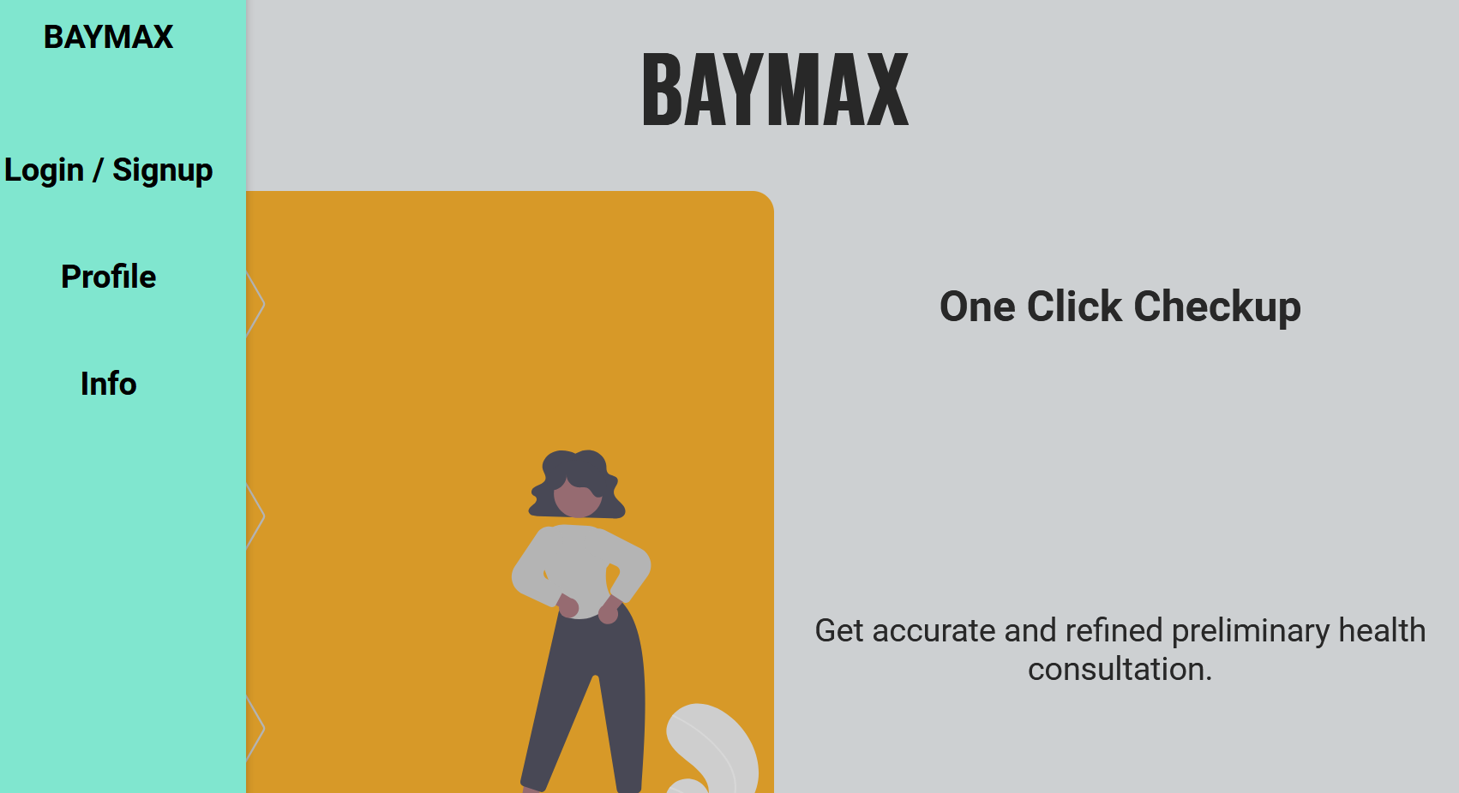
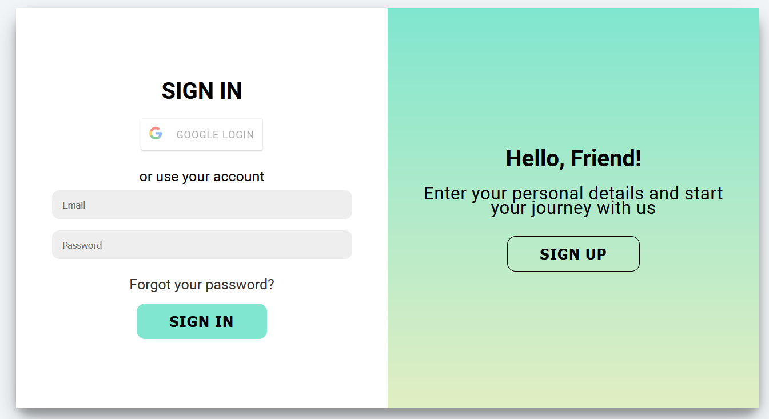
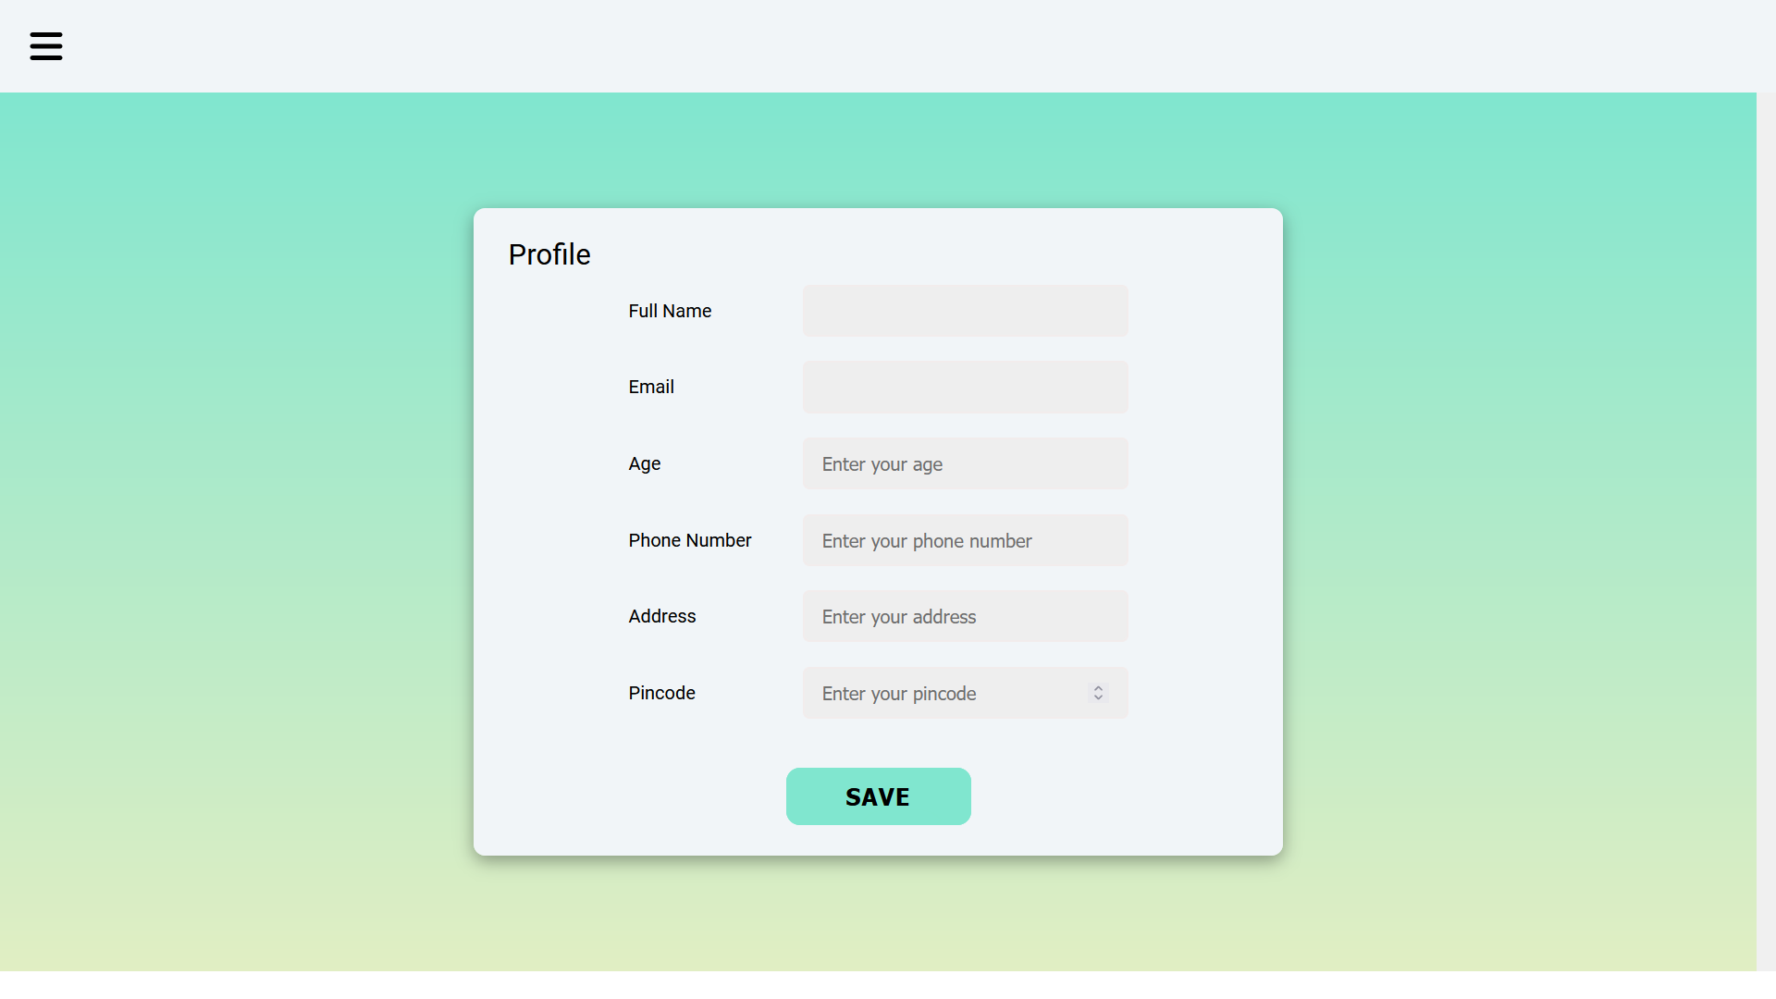
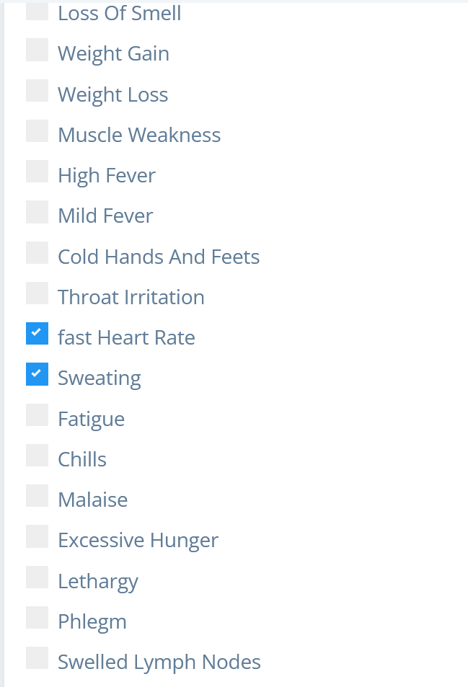
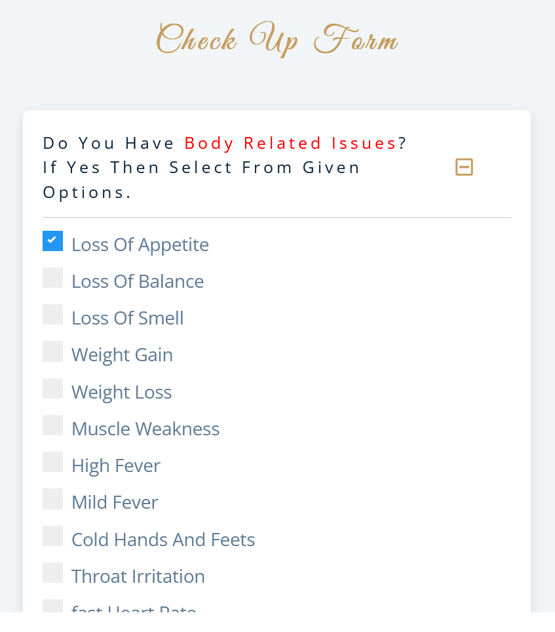

Work Flow

Slide 5
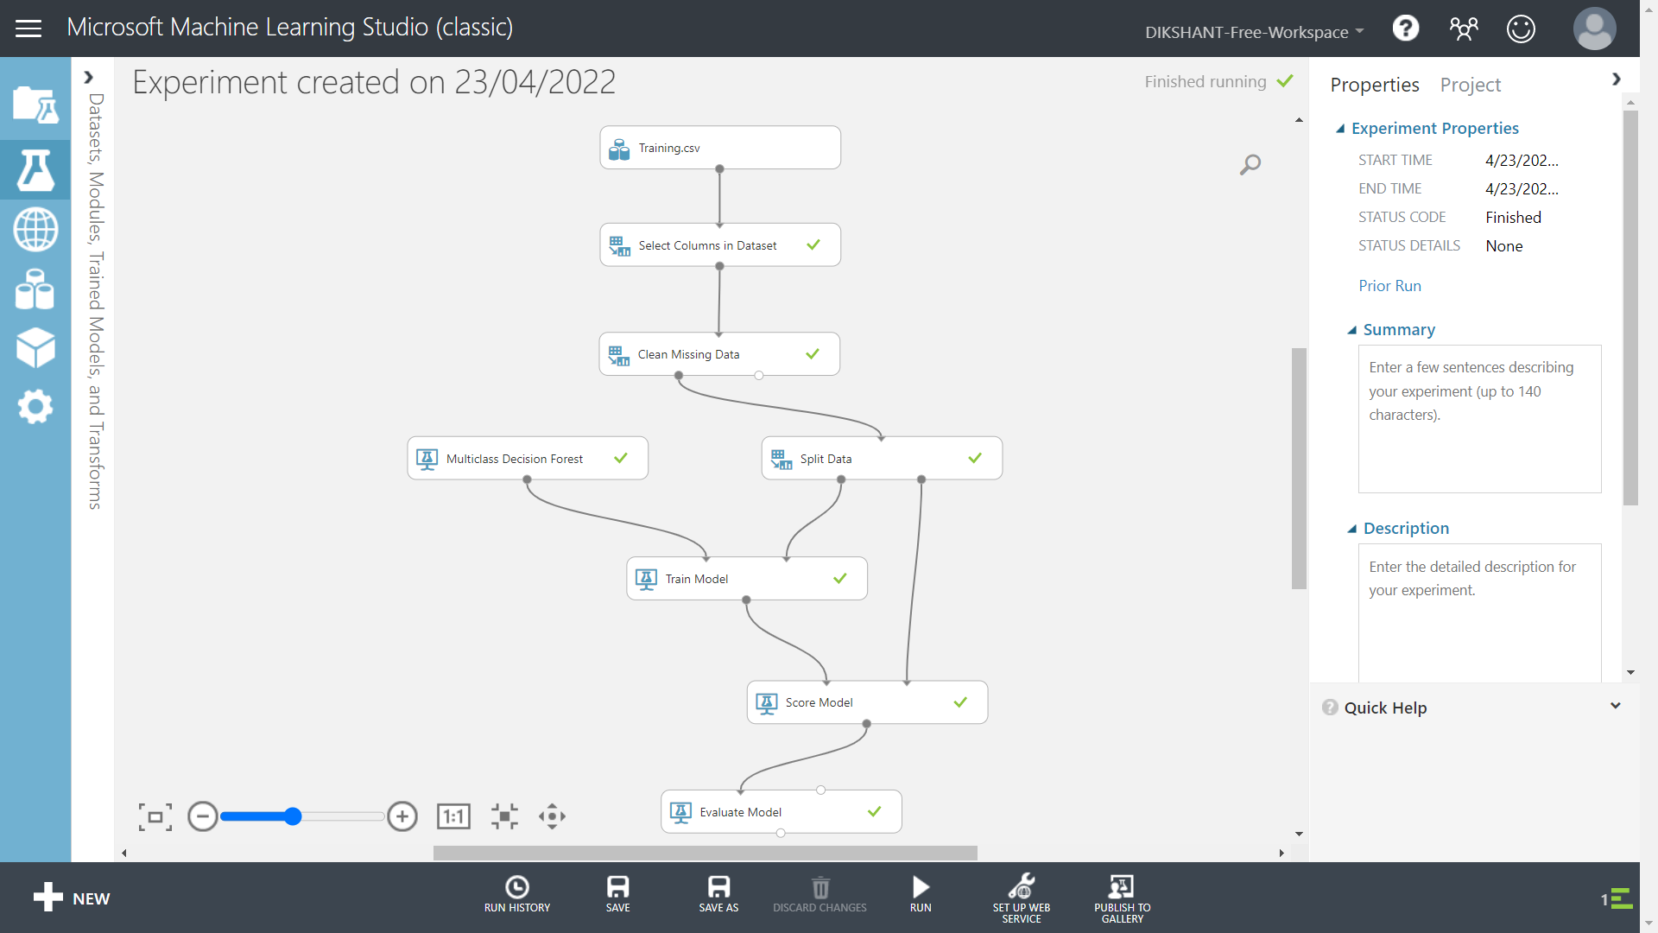
Training models on Microsoft Azure ML Services

Slide 6





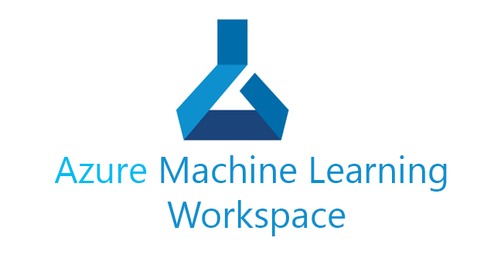








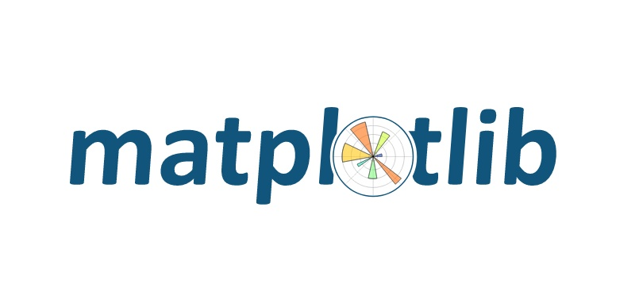


Tech Stack

Slide 7
Uniqueness of Baymax
Preliminary analysis of a disease thus, we alert the patient about the criticality about the disease he/she is suffering from.
Get to know about the disease before hand consulting a doctor.
No need to waste time on searching google, it always shows cancer.
Machine learning system will provide user information of specialized hospital

Slide 8
Future Possibilities and scope
Providing information of nearest hospital and making a reservation.
Providing specialized doctors in that category of disease.
Virtual support of doctors 24/7.
We can improve our models by increasing the training dataset.
We can expand our web app to Android.

